Slide 1

RATING PREDICTIONS model build by using various machine learning algorithms
BY: SEEP BANSAL

Slide 2
PROBLEM STATEMENT
We have a client who has a website where people write different reviews for technical products. Now they are adding a new feature to their website i.e. The reviewer will have to add stars(rating) as well with the review. The rating is out 5 stars and it only has 5 options available 1 star, 2 stars, 3 stars, 4 stars, 5 stars. Now they want to predict ratings for the reviews which were written in the past and they don’t have a rating. So, we have to build an application which can predict the rating by seeing the review.

Slide 3
INTRODUCTION
E-commerce these days plays a vital role in our life and one of the most important components of e-commerce is Online shopping.
Online shopping took a significant segment of retail market during first decade of the 21st century. Interestingly, India is expected to be the third largest Internet market in the world in the next five years. The various online platforms are available where one can shop online are amazon, myntra, flipkart and many more.
One can avail various products like electronics, mobile phones, home decors and clothes and many more.
These online shopping websites also provides us the facility where a buyers can add their own reviews about the product and the ratings for the same.

Slide 4
PROJECT SUMMARY
Though these online platforms provide us various options to shop online like clothes, electronics, Smart TV and various other appliances reviews and rating for the same plays very important role as it helps the user to make purchase easy.
The focus of this project is to develop a machine learning model that can accurately predict the rating of a product based on reviews given by the user.
Various machine learning algorithms like Logistic Regression, Support Vector Mechanism, Decision Tree Classifier, Random Forest Classifier, Ada Boost Classifier are implemented and evaluated to predict the rating of the product. The best results are given by Decision Tree Classifier.

Slide 5
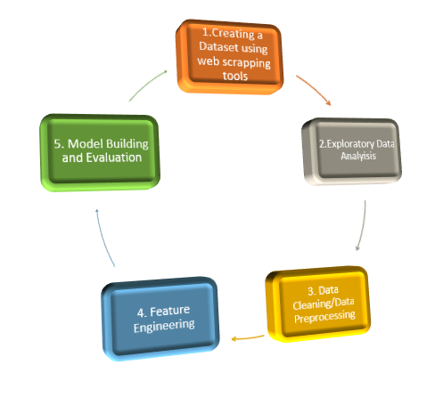

Slide 6
DATASET
For this project the data is collected from one of the leading platform called www.flipkart.com. The rating, rating summary and the reviews have been collected for the various products like iphone, Smart TV, Smart watches etc. The data is scrapped from the website using the web scrapping tools like selenium and beautiful Soup using Python language.

Slide 7
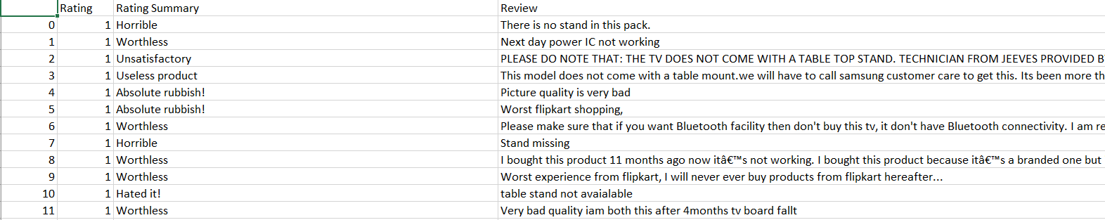
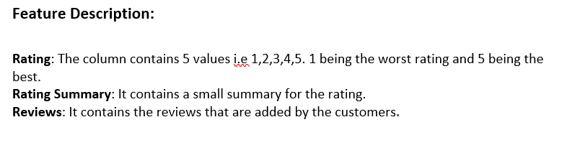

Slide 8
EDA CONCLUDING REMARKS
There are null values in the dataset.
Calculation of VIF Factor to check the presence of multicollinearities among the difference variables.
We will be performing standard scaling technique to bring all the columns on the same scale.
Skewness of the model was checked.
As the dataset was imbalanced the SMOTE technique was followed to balance the dataset.
As the dataset is in the categorical form the data label encoding was done to convert the data into numeric form.

Slide 9
VIZUALIZATION

Slide 10
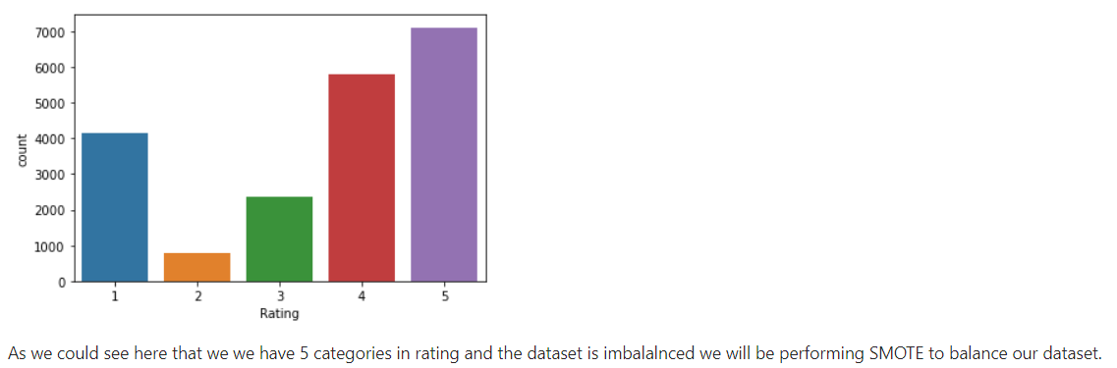
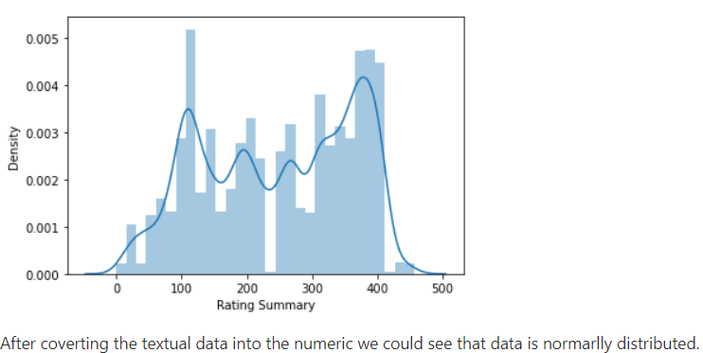
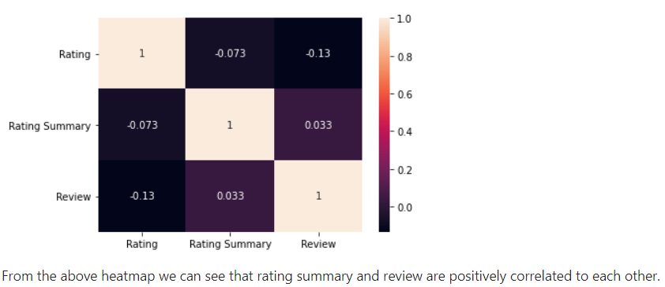

Slide 11
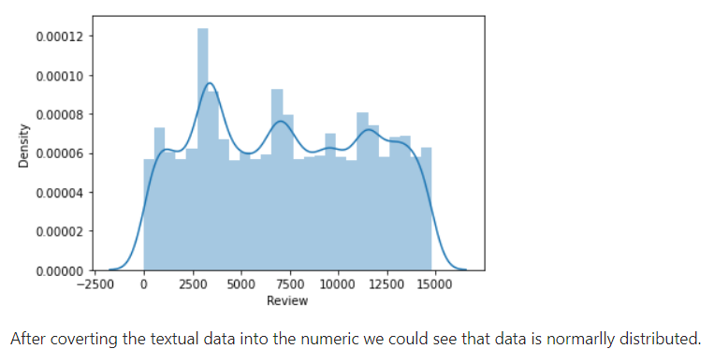
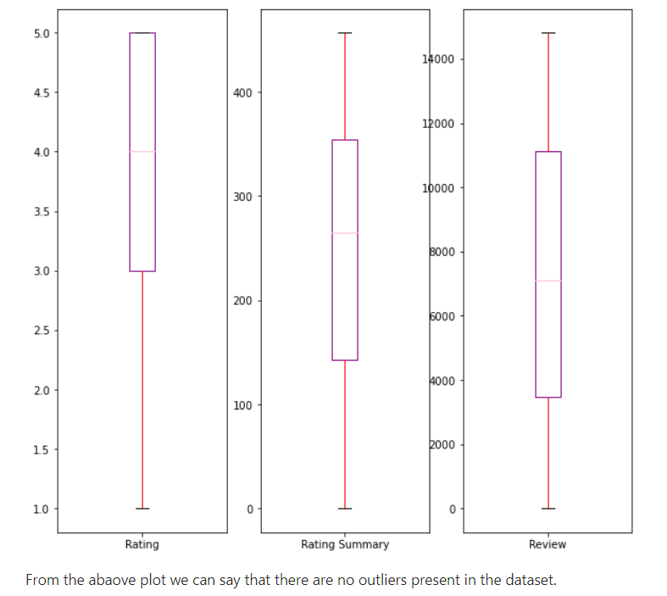

Slide 12
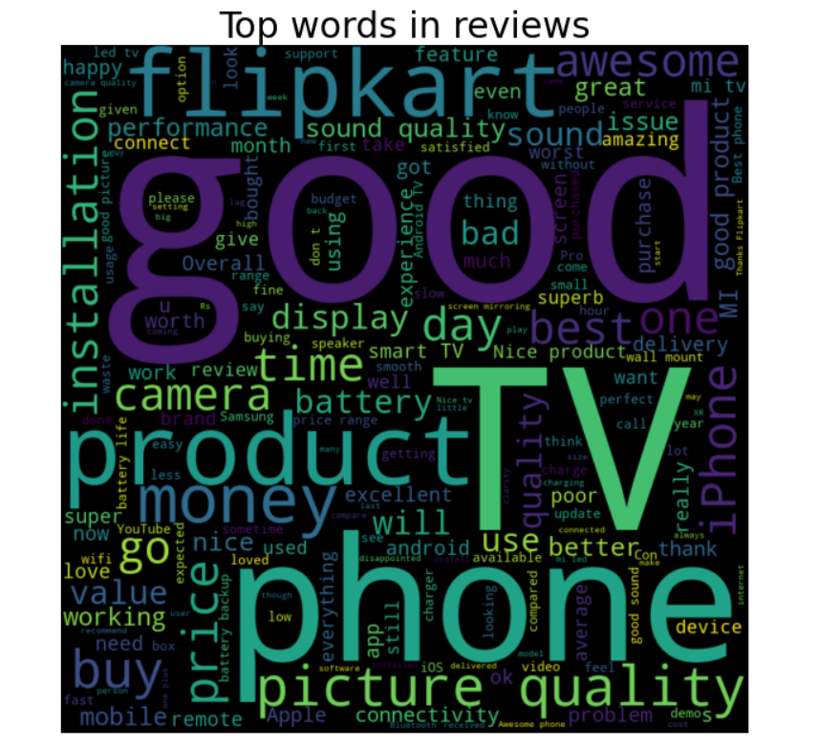

Slide 13
CLASSIFICATION EXPERIMENTS
We have performed various classification algorithms like Logistic Algorithm, Decision Tree Algorithm, Ada Boost Classifier, Random Tree Classifier to check the accuracy. The main algorithm which has predicted the best results is the Decision Tree Classifier. Here, the Decision tree classifier is giving us the best results with the accuracy score of 99%.

Slide 14
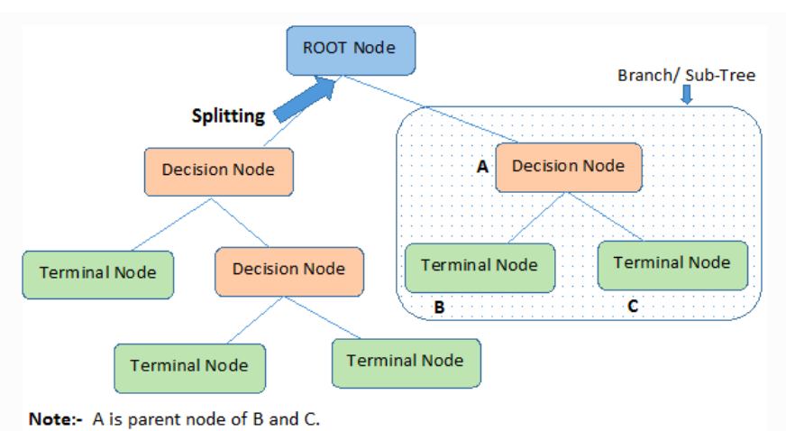

Slide 15
EVALUATION MATRIX
Evaluation matrix plays a very important role in evaluating the performance of any classification model. The metrices that are evaluated here are the accuracy score, ROC_AUC score, classification matrix which includes F1, recall, Precision and the confusion matrix. Time taken to test the model on dataset plays a very crucial role. Here, for Decision Tree Classifier the accuracy score we are getting is 99% and the classification matrix i.e precision, F1, recall also scores to 99% and the confusion matrix shows that some values lie in the error type 1 and 2 as the model is predicting with 99% accuracy.

Slide 16
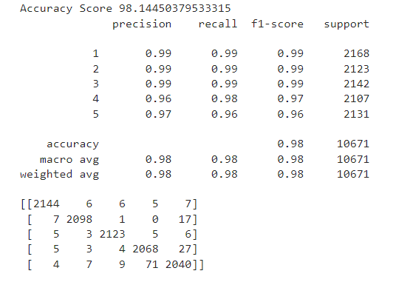
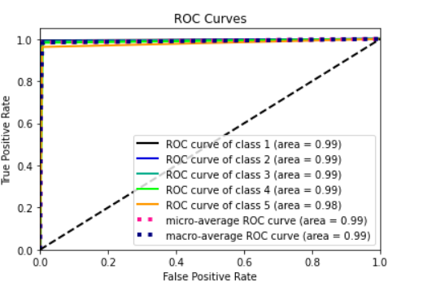

Slide 17
CONCLUSION
Deciding upon the rating of the product based on the reviews entered by the user plays a very crucial role as it only helps the user make a perfect purchase but also helps the website to increase the loyal buyer as well as increases its business. Though it a very challenging task to decide upon the rating based on the reviews but on the other hand it is very important too. The focus of this project is to develop a machine learning model that can accurately predict the rating of a product based on reviews given by the user. Various machine learning algorithms like Logistic Regression, Support Vector Mechanism, Decision Tree Classifier, Random Forest Classifier, Ada Boost Classifier are implemented and evaluated to predict the rating of the product. Here, for Decision Tree Classifier the accuracy score we are getting is 99% and the classification matrix i.e precision, F1, recall also scores to 99% and the confusion matrix shows that some values lie in the error type 1 and 2 as the model is predicting with 99% accuracy.

